Slide 1
Beware of catastrophic flood events with properties of Black Swan in the midst of COVID-19 spreading around world
大疫之中话防汛，尤须慎防“黑天鹅”
Xiaotao CHENG 程晓陶
China Institute of Water Resources and Hydropower Research
中国水利水电科学研究院

Slide 2
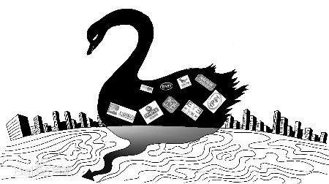
COVID-19, a typical catastrophic event of Black Swan
新冠肺炎，典型具有“黑天鹅”属性的巨灾事件
The COVID-19, which is now spreading around the world, let human societies suffer an unpredictable catastrophe as Black Swan event again in 2020. The lessons we have drawn from this Public Health Emergency of International Concern (PHEIC), which has evolved into a social and economic crisis with far-reaching impacts, were painful and profound.
2020年，蔓延全球的新冠病毒，让人类再次遭受了“黑天鹅”巨灾事件的肆虐，一次“国际关注的突发公共卫生事件”演变为影响深远的经济危机和社会危机，教训惨痛而深刻。
Properties of “Black Swan” event
黑天鹅事件的特点：
It‘s serendipitous/它具有意外性。
It could have significant impact/它产生重大影响
It is hard to predict, but in hindsight it is more or less explicable and predictable/虽难以预料，但事后或多或少认为它是可解释和可预测的。

Slide 3

The epidemic has not subsided, while the flood season is coming, the pressure of flood protection doubled
疫情未息，汛期已至,防汛压力倍增。
Given the sharp declines of economy in the first 4 months of the year due to the COVID-19, there is no doubt that worries may have multiplies if we are hit again by the potential severe floods. Therefore, it is strictly necessary to anticipate and make all the preparation ahead, strive to turn the disastrous flood water into available water
resources, and provide stronger supports to the earliest recovery of the society and the economy.
在头 4个月经济发展严重受挫的情况下，若因洪灾再遭重创，无疑忧患倍增，为此尤须未雨绸缪，力争化害为利，为夺取脱贫攻坚战全面胜利提供支撑与保障

Slide 4
Recognize the characteristics of different disaster stages and adjust the response strategy timely
认清灾害阶段特征，适时调整应对方略
Every major sudden disaster, accident or event always has a process of incubating, outbreaking, spreading and subsiding. Despite that their causes, forming mechanisms, spreading modes and coping measures vary, all of them must be handled with all-out efforts in risk prevention, monitoring and early warning, emergency responses, relief and resettlement, and recovery and restoration, and with flexible and timely adjusted tactics that are positive response to the actual situations.
凡突发性重大灾害、事故或事件，都有孕育、暴发、蔓延、平息的过程，尽管灾难成因、 孕发机制、蔓延方式与应对措施各有不同，但都需要在风险防范、监测预警、应急响应、救援安置、恢复重建等各个环节全力以赴，因势利导，适时调整应对策略。

Slide 5
If emergency response in any stage is not in place, the disaster losses may be irreparable
任何环节应变不到位，灾害损失恐难以挽回
For the Black Swan events, which rarely occur but usually lead to unpredictable disastrous consequences, the key lies in whether the precursory signals and real-time information can be closely traced, constantly updated, and promptly reported to responsible departments from the front-line; whether the possible scale and severity of the disaster can be anticipated in a quick, fact-based and rational manner; and whether the coping strategies and measures can be adjusted according to real situations.
针对发生概率低，会造成出乎预料巨大灾难性后果的“黑天鹅”事件，关键在于紧密追踪各种前兆与实时信息，及时基于一线与专业部门的报告，对灾难事件的可能规模与危害程度迅速做出实事求是的理性预判，适时根据客观条件调整应对策略与措施。

Slide 6
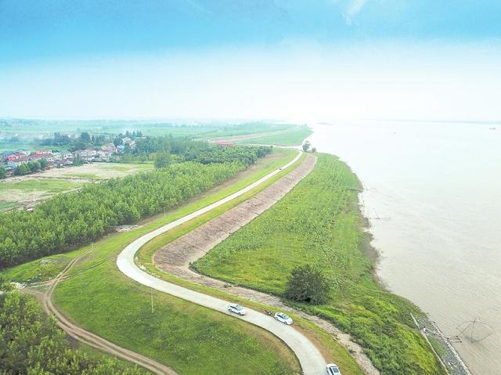
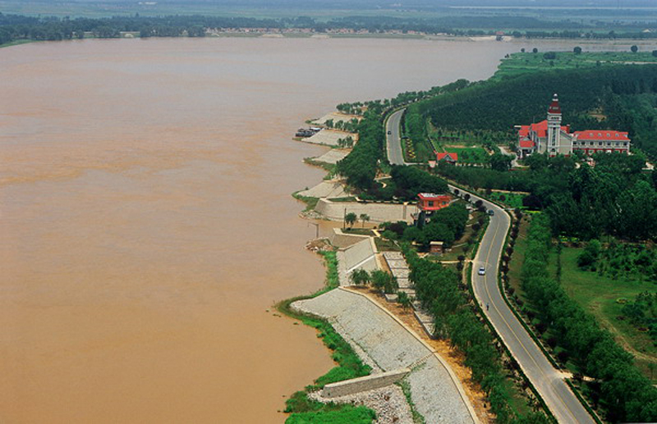
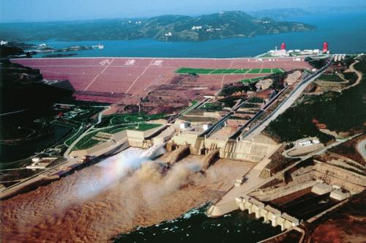
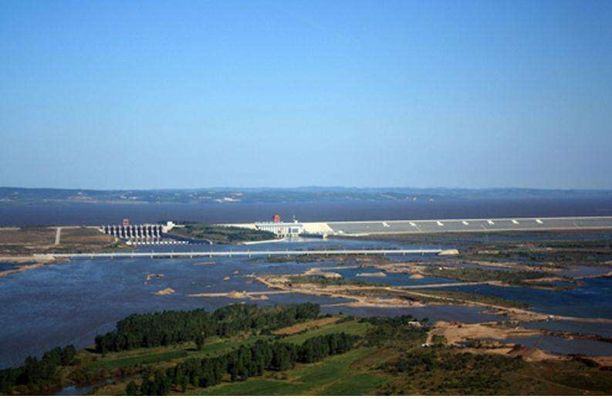
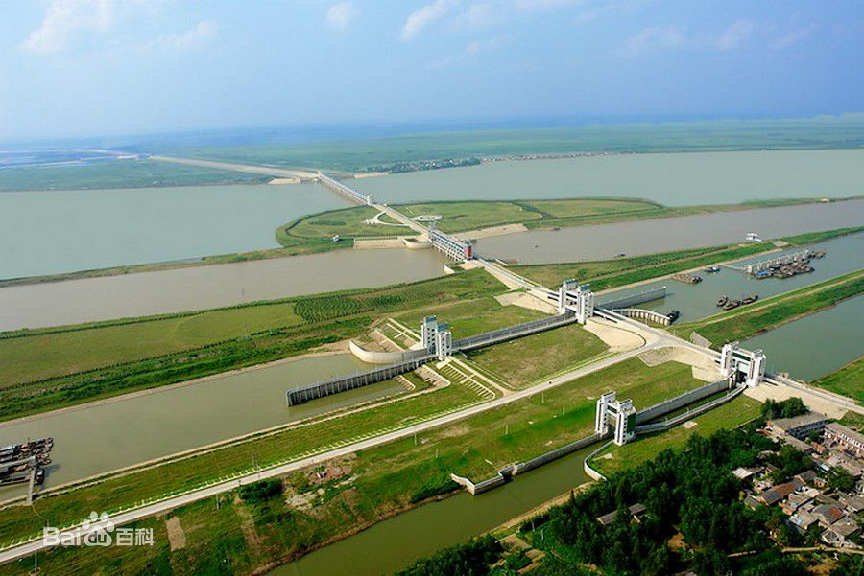
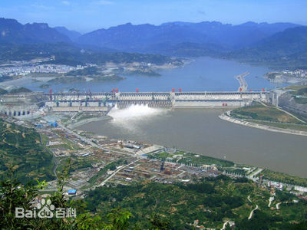


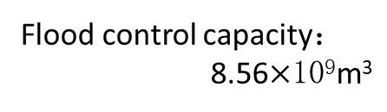

Significantly improved flood control capacity since 1998
1998年之后全国防洪能力有显著增强
长江干堤加固3576km
（1999-2008）
历史最高水位
+2m超高
As a result, the lengths of the river banks protected by well-maintained dikes increased from 76,532km in 1998 to 201,124km in 2016 and reservoir capacity increased from 493 billion to 932 billion cubic meters. A number of flood control projects, such as the Xiaolangdi Dam on the Yellow river and the Three Gorge Dam on the Yangtze river were completed.
堤防护岸长度由1998年的76 532km增加到2016年的201 124km，
库容由4930亿m³增加到9320亿m³。黄河小浪底大坝、长江三峡
大坝等防洪工程相继竣工。
黄河标准化堤防923km
(2002—2015)
顶宽10～12m
防浪林30～50m
淤背体100m
Total storage：12.65$×$10⁹m³
Flood control capacity：
4.05$×$10⁹m³
Total storage : 8.61$×$10⁹ m³
Flood control capacity：
2.37$×$10⁹ m³
Flood control capacity：
8.56$×$10⁹m³
Flood control capacity：
22.15$×$10⁹m³
黄河小浪底水利枢纽（2001）
嫩江尼尔基水利枢纽（2006）
淮河临淮岗洪水控制工程（2006）
长江三峡水利枢纽（2009）
Notes:
超;高： superelevation ; 防浪林：wave break forest; 淤背体：silt body on the back of levee

Slide 7
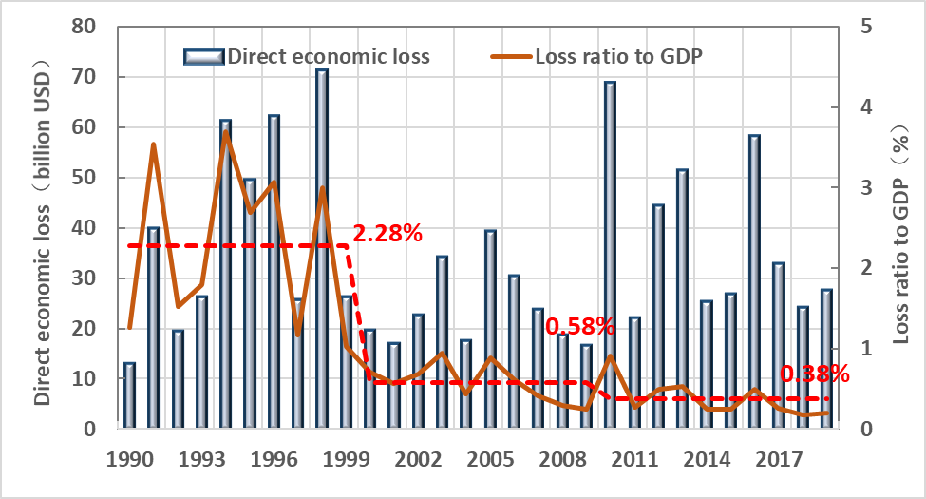
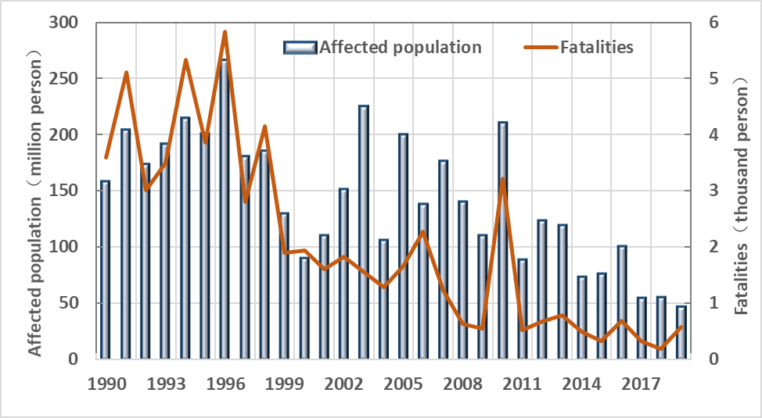
Flood losses and flood fatalities in China (1990-2019)
中国洪灾经济损失与因灾死亡人数（1990-2019）
(a) Flood losses (in 2015 USD) (b)Flood fatalities
Data source: MWR: China Flood and Drought Disaster Bulletin 2019, China Water Power Press, Beijing, 2020. 中国水旱灾害公报2019，中国水利出版社，北京，2020

Slide 8
Since 2006, more than 100 cities were inundated every year, the annual total flood damages is proportional to the number of affected cities.2006年以来每年受淹城市都在百座以上，年洪灾损失总数与受淹城市数乘正比.
Challenges on urban flood prevention
城市防洪面临的挑战
Mutation : Urbanization + higher standard
突变性：城镇化+较高防洪标准
Flood protection standard raising
防洪标准提高
洪灾损失
Flood damages
Economic developing经济发展
Annual direct flood damages (10⁹ CNY)
Inherent flood damage features 原有损失特征
2016
2010
2012
2013
1998
重现期Return period
Mutability of Urban Flood Damages洪灾损失突变性
Urbanized areas expanding to the low-lying areas；城市向低洼易涝区扩张;
Increasing properties and population in flooded regions；受淹区中人口、资产增长;
Normal operation of the city greatly depends on the lifeline system.现代城市正常运行极大依赖于供水、供电、供气、交通、通讯等生命线系统。
2014
2006
2015
2011
2007
2008
2009
受淹城市数 Number of flooded cities (2006-2016)

Slide 9
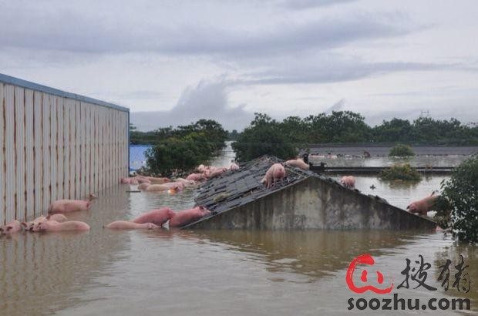
New issues in flood control under the new situations
经济社会发展新形势下防洪面临的新问题
A large number of young labors left for finding jobs in cities, that weaken the capacity of flood fighting in rural areas；大量农村青壮劳力进城务工，汛期巡堤、查险、排险、抢险、转移、救灾等工作人员严重不足；
The land in the polder areas under the intensive management of big-specialized-household is up to 40%～90%, that brings challenges to flood fighting and disaster mitigation； 农村土地流转为大户经营已达40%至90%，为抗洪抢险救灾工作带来挑战与机遇；
There is a big gap in the level of economic development, and the flood control work has not yet formed an organic operation mechanism combining market and plan.经济发展水平差异大，防汛工作尚未形成市场与计划有机结合运作机制，贫困县乡村集体完全承担防汛责任，不堪重负。
The Yuanfeng pig farm co., LTD has more than 13,000 pigs, only about 3,000 of which are alive. With the addition of plant, equipment and feed, the loss is estimated to be 30 million.

Slide 10
In particular, we must guard against type of the over-standard flooding with properties of the black swan
尤须警惕黑天鹅型的超标准特大洪水
In face of flood, human beings are capable of monitoring, forecasting, early-warning, responding and regulating, and also adaptable to flooding in some extent. However, this is not enough to cope with the extraordinary floods, which also bear the properties of Black Swan events. Averagely, with nearly 100,000 reservoirs in China, even if there were several accidents in a year, the probability might be less than 1 in 10,000 ; for the dykes and embankments that stretch more than 400,000 km, even if hundreds of them fail per year, that only accounts for less than 1 in 1000 by accident rate per km.
人类对洪水有一定的监测、预报、预警及防范与调控的能力，对泛滥洪水也有一定的适应能力。但是，超标准的特大洪水，同样具备了“黑天鹅”的属性。平均而言，我国有近 10 万座水库，即使一年有数座出险，概率也小于万分之一；我国有 40余万公里长的堤防，即使一年有数百处堤防出险，每公里失事概率也小于千分之一。

Slide 11
To cope with the overflow of flooding, we need unified command and coordination
应对超标准洪水，需要统一指挥协调行动
It should be noted that reservoirs and embankments of different grades adopt varying design standard. Once extraordinary rainstorm floods happen, it would be impossible to make accurate forecast on which part of the project would fail in a year. On the other hand, most of the administrative governors who bear the responsibility of command but lack field experience in handling real floods, let alone the disaster chains resulting from several different kinds of disasters, or the chain effects formed among lifeline systems.
但是不同等级的水库与堤防都有一定的设防标准，一旦发生超标准暴雨洪水，何处工程可能失事，并非预先能够准确预测的。承担防汛指挥责任的各级行政首长，大多缺少应对洪灾的实际经验，尤其当多灾种间形成灾害链，或生命线系统间形成连锁反应时。

Slide 12
Strengthen the capacity building of risk management and emergency management
加强风险管理与应急管理的能力建设
Risk management and emergency management are the main threads that are mutually complementary in the construction of the public security guarantee system. In tackling the black-swan-type floods, decisions are usually made with the manner of “evaluating the dangers and picking the lighter one”, thus it becomes rather difficult to ensure absolute safety. Being overly hesitant during the critical moments may spoil the chance to win the battle, leading to more serious consequences.
风险管理与应急管理，是公共安全保障体系构建中相辅相成的两条主线。应对“黑天鹅” 型超标洪水的决策，往往是“两害相权取其轻”，难以做到“万无一失”。关键时刻过多患得 患失，反而可能贻误战机，导致更为严重的后果。

Slide 13
Take overall consideration, try to turn harm into benefit, beware of caring for one and losing the others
统筹兼顾，力求化害为利，谨防顾此失彼
It is important to realize that floods always come as a double-edged sword. For many places, one flood or two during the flood season remain the main sources of water supply. Therefore, adopting the “zero risk” strategy may bring excessive costs for the flood control, hindering the economic recovery, and threaten the security of food, drinking water, water supply, the economy and the eco-environment. In a word, the flood-prevention work in 2020 is rather complex and challenging.
同时也要认识到，洪水是具备利害两重性的，汛期的一两场洪水，往往也是许多地方水资源的主要补给方式。在防汛上的“0 风险” 管控，很可能过高增加抗洪的成本，顾此失彼，反而不利于大疫之后的经济复苏，并威胁到供水安全、饮水安全、粮食安全、经济安全与生态安全。

Slide 14
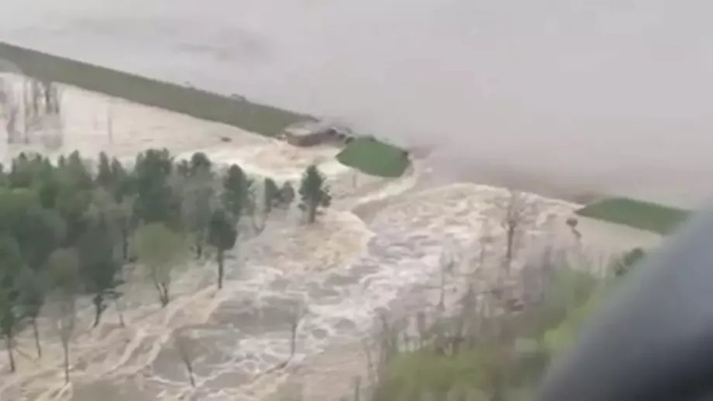
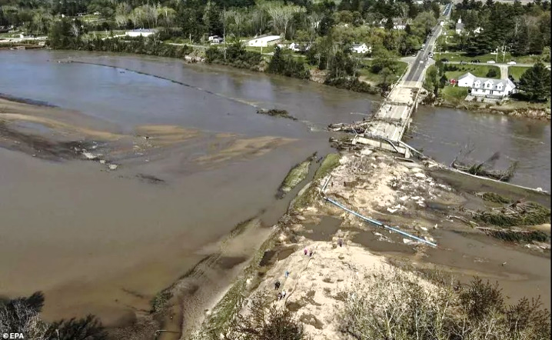
Summary / 结语
Above all, we must bear the moderate risks with a strong sense of responsibility, enhance the inter-departmental and multi-agency coordination by mobilizing the forces of grass-roots organizations and the public, and adopting scientific strategies and targeted measures, so as to turn the harm into benefit and bring safety to the people.
Edenville Dam breached in record rainfall
This truly is a historic event that is playing out in the midst of another historic event.
总之，2020 年的防汛形势十分复杂、严峻，唯有肯担责任，适度承受风险，加强部门间的协调联动，发挥基层组织的能动作 用，充分依靠人民群众，科学防控，精准施策，才可能除害兴利，完成防汛抗旱的艰巨任务。
- G. Whitmer, governor of Michigan on May 19, 2020
警钟长鸣，有备无患！

